Slide 1
SRSD Day3 worksheet
Instruction: This activity involves a group discussion. Each participant is required to submit their work individually, although it's permissible to submit the same file as their teammate.

Slide 2
Team members
List your team members’ full name (as in your course registration)

Slide 3
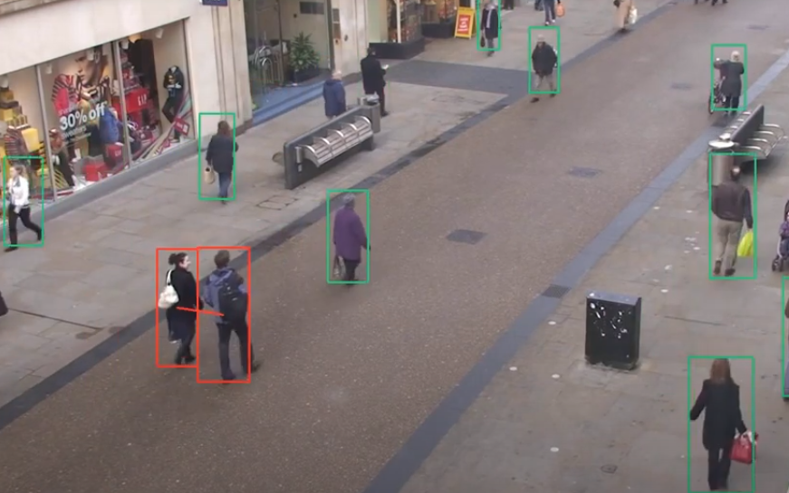
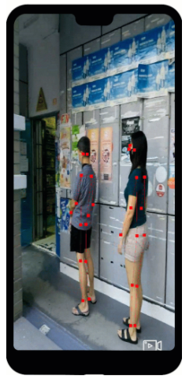
Case study
Solution 1: Landing.AI. https://landing.ai/landing-ai-creates-an-ai-tool-to-help-customers-monitor-social-distancing-in-the-workplace/
Solution 2: FinePose (AI Singapore) https://aisingapore.org/finepose/, https://aisingapore.org/2020/05/finepose-2/

Slide 4
Technical discussion
 | Solution 1: Langding.ai | Solution 2: FinePose
Technical solution: How is the social distance inferred?
Limitation: When would the solution fail?
Do you think the additional depth sensor/data could help with the system?

Slide 5
Business discussion
If you are the business owner (e.g., shopping mall owner or facility manager), provide one reason to agree to deploy these solutions, and provide one reason to decline these solutions.
 | Solution 1: Langding.ai | Solution 2: FinePose
Agree to deploy
Decline to deploy

